Slide 1


Fundamentals
Where do I find MATLAB? Here!
Do I have to have MATLAB installed on my computer right now? No, you can use MATLAB Online!

Slide 2

Table of Contents
Fundamentals What we've covered this week in Part 6 MATLAB Grader What we've covered this week in Part 7
MATLAB Live Script

Slide 3
What we've covered this week in Part 6
This week in Part 6 we learnt about:
Live Scripts
Code sections
Providing documentation
MATLAB code files

Slide 4
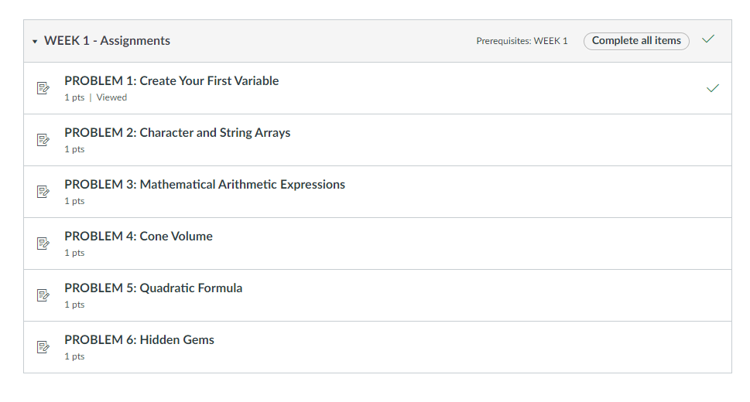
MATLAB Grader
Every week you’ll complete a set of problems on everything you’ve learnt in that week. You will find these problems in the weekly assignments under "Modules" in Ulwazi. Each weekly assignment contains one or more problems, as shown below.

Slide 5
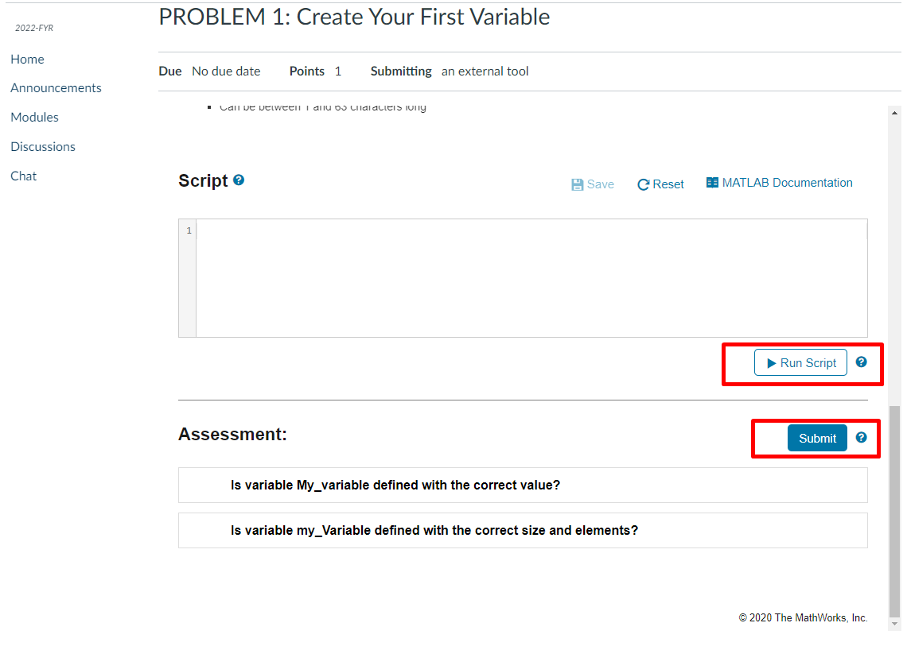
MATLAB Grader
To complete the weekly assignment, submit one or more correct solutions for each problem. Before you submit your solution, you have the option of running the code to check your output (Run Script/Run Function).

Slide 6
What we've covered this week in Part 7
This week in Part 7 we learnt about:
MATLAB Grader

Slide 7
MATLAB Live Script
Click on the link below for this lecture’s MATLAB live Script
Week_1_Part_7_Fundamentals.mlx
Copyright 2022 The MathWorks, Inc. & Opti-Num Solutions (Pty) Ltd.

